Slide 1

The Best of Both Worlds
Office 365 and
Windows Server 2012 R2
Mark O’Shea
MVP Windows Expert – IT Pro
Global Partner Advisory Council – Office 365
June 2014

Slide 2


Agenda
Deliver the Best of Both Worlds
Benefits extend in both directions
Windows Server 2012 R2
Leveraging the Essentials role and much more
Office 365
What is it and how is it different to previous offerings
Migration Options For Your Customers
How to get from then to now

Slide 3
Agenda
Deliver the Best of Both Worlds
Benefits extend in both directions
Windows Server 2012 R2
Leveraging the Essentials role and much more
Office 365
What is it and how is it different to previous offerings
Migration Options For Your Customers
How to get from then to now

Slide 4
Demonstration
Office 365
www.microsoftofficedemos.com

Slide 5

AKA.MS/DEMOARMY

Slide 6
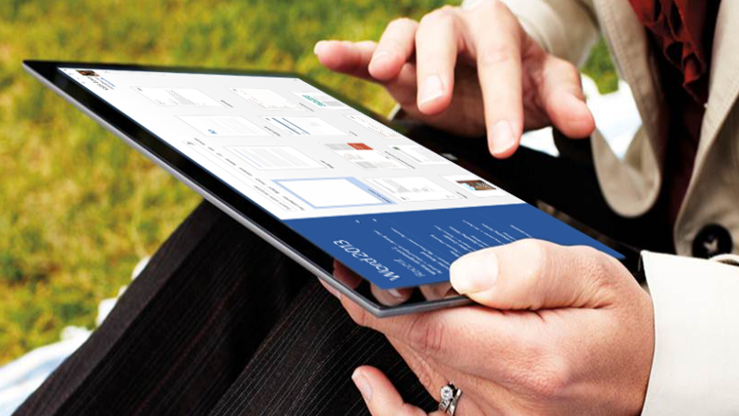

Today’s workplace needs…
Freedom and flexibility to work anywhere, while ensuring that data and apps are protected
Freedom & Flexibility
Mobile & remote access
Any device
Protection & Control
Data protection
Secure access

Slide 7


Get the Best of Both Worlds
Offer customers the power of cloud productivity with the need for on-site data control
Cloud Productivity
Use latest Office on PC, Mac, tablet, or smartphone
Anywhere access to email, docs, and online meetings
Always up-to-date malware protection
On-Site Data Control
Keep critical data on-premises when needed
Access on-site apps like accounting & CRM remotely
Enjoy automated backup of your data and apps

Slide 8


Office 365
Cloud-based productivity
Bring together the familiar Office apps with cloud services like email, file sharing, & HD videoconferencing
Use Office across your devices — PC, Mac, tablet, smartphone — and know it’s always up-to-date
Get robust security with automatic data backup, strict privacy policy, & always up-to-date malware protection
Enterprise-quality productivity tools at an affordable price and no upfront infrastructure investment

Slide 9

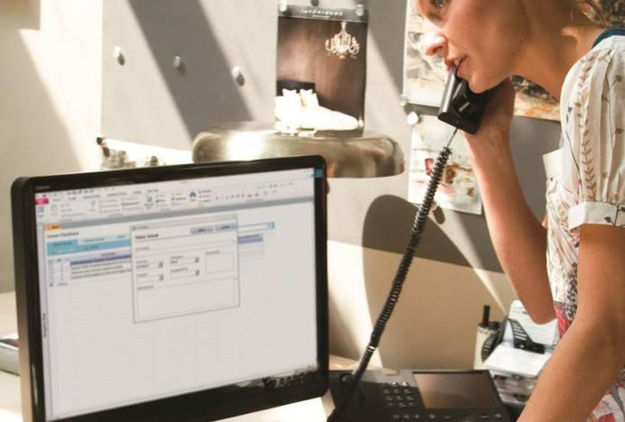
Windows Server 2012 R2
On-site data control
Provide seamless remote access to applications
and data with highly secure, always-on connectivity
Get the enterprise-level data protection you need, regardless of your business size
Increase the storage capacity available to your employees without downtime
Easily manage your cloud and on-site environment to ensure everything is backed up and running smoothly

Slide 10


Flexibility & Peace of Mind for SMBs
Office 365 + Windows Server 2012 R2
Use cloud-based email, plus file sharing and HD video conferencing, all working seamlessly with the familiar and always up-to-date Office apps
Enjoy a predictable and affordable monthly cost
for best-in-class productivity tools
Enable easy, well-controlled remote login to on-site business applications, like accounting and CRM
Use virtualization to reduce costs and get the most out of your server hardware as you grow your business

Slide 11
Agenda
Deliver the Best of Both Worlds
Benefits extend in both directions
Windows Server 2012 R2
Windows Server 2003 EOL and Leveraging the Essentials role
Office 365
What is it and how is it different to previous offerings
Migration Options For Your Customers
How to get from then to now

Slide 12

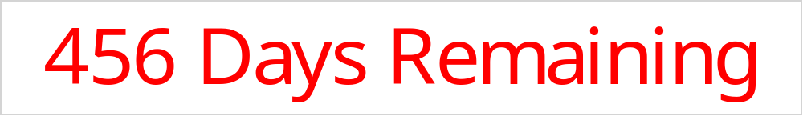
End of support for Windows Server 2003/R2

Slide 13
Migration process
1
2
3
4
Discover
Catalog your software and workloads
Assess
Categorize applications and
workloads
Target
Identify your destination(s)
Migrate
Make the move

Slide 14
Discover what you have
1. Discover
2. Assess
3. Target
4. Migrate
Catalog your software and workloads
Self-service tools
  Microsoft Assessment and Planning (MAP) Toolkit provides
  Secure, agentless, network wide inventorying
  Supports networks of all sizes
  Centralised collection and reporting

Slide 15
Assess your inventory
1. Discover
2. Assess
3. Target
4. Migrate
By type
  Microsoft
  server roles
  Microsoft
  applications
  Custom
  applications
  Third-party applications
By criticality
  Mission critical
  Important
  Marginal
  Can be retired
By complexity and risk
  Low
  Medium
  High

Slide 16
Target your destination
1. Discover
2. Assess
3. Target
4. Migrate
Evaluate options for each application and workload
Windows Server
2012 R2
Microsoft
Azure
Cloud OS
Network

Slide 17
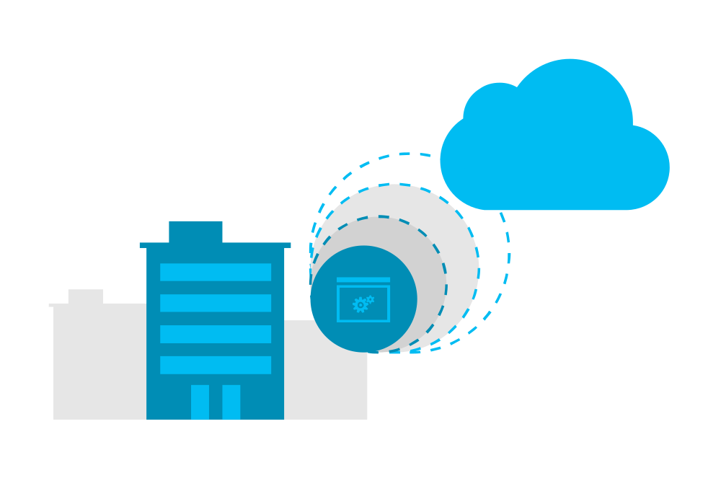
Migrate your workloads
1. Discover
2. Assess
3. Target
4. Migrate
Do it
yourself
Consider service offerings
Plan
Execute

Slide 18
How to Buy Windows Server 2012 R2
Choose from four editions of Windows Server, based on the size of the customer organization and their requirements for virtualization and cloud computing.
Edition
Ideal for…
Feature Comparison
Licensing Model
Datacenter
Highly virtualized private and hybrid cloud environments
Full Windows Server functionality with unlimited virtual instances
Processor + CAL*
Standard
Low density or non-virtualized environments
Full Windows Server functionality with two virtual instances
Processor + CAL*
Essentials
Small business environments for servers with up to two processors
Simpler interface, pre-configured connectivity to cloud-based services; one virtual instance of Essentials
Server (25 User Limit)
Foundation
Economical general purpose server with a single processor
General purpose Server functionality with no virtualization rights
Server (15 User Limit)
Windows Server 2012 R2 Standard and Datacenter editions include the new Windows Server Essentials Experience server role, offering features such as Remote Web Access and client computer backup that previously were only available through the Windows Server Essentials edition.
*CALs are required for every user or device accessing a server. See the Product Use Rights for details

Slide 19



Windows Server 2012 R2 Essentials
Helps your minimize the time, effort, and money that you spend on IT.
Protect
your data
Simplified backups
Built-in disaster recovery
Simplified management
Provide secure
remote access
Consistent productivity
Easy connectivity
Increased security
Integrate
cloud services
Business agility
Flexible cloud options
Improved management.

Slide 20
Deployment options
  Windows Server Essentials edition:
  Physical deployment
  Windows Server 2012 R2 Essentials
  Windows Server Essentials edition:
  Virtual deployment
  Windows Server 2012 R2 Essentials and Hyper-V
Windows Server Essentials Experience role
Windows Server 2012 R2 Standard or Datacenter edition

Slide 21

Typical primary server deployment
No Hyper-V parent partition
Windows Server 2012 R2 Essentials
Running directly on the physical hardware
  Replacement for peer-to-peer networking and PC-as-a-server
  Often deployed pre-installed on physical hardware
  Apps run on the server
  Messaging and collaboration in the cloud
  Other cloud-based apps and services
No hypervisor
Hardware
Together with optional online apps and services

Slide 22
Essentials edition includes the Hyper-V role
Windows Server 2012 R2 Essentials
Parent partition to run and manage the Hyper-V role
Windows Server 2012 R2 Essentials
Child partition running a virtual machine
  Deployment model uses a single Windows Server Essentials license
  Hyper-V server role is now available with the Essentials edition
  Install Hyper-V in the server’s parent partition and run Windows Server Essentials as a guest virtual machine
  Enables capabilities that require running as a virtual machine, such as Hyper-V Replica
Hyper-V hypervisor
Hardware
Together with optional online apps and services

Slide 23
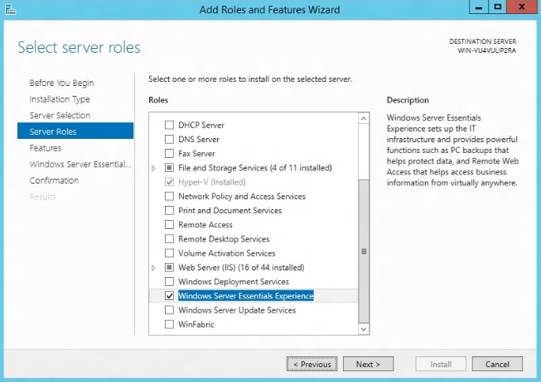
Windows Server Essentials Experience role
Windows Server Essentials functionalities are enabled with a server role across all mainstream Windows Server editions
Familiar seamless deployment experience sets up the most fundamental roles for the primary server
Optional unattended deployment and configuration using Windows PowerShell

Slide 24
Standard or Datacenter editions help you scale
Windows Server 2012 R2 Standard
Parent partition to run and manage the Hyper-V role
Windows Server 2012 R2 Standard with WSEE role
Child partition running a virtual machine
Windows Server 2012 R2 Standard
Child partition running a virtual machine
  Deployment model uses Windows Server 2012 R2 Standard or Datacenter license
You can enable the new Windows Server Essentials Experience (WSEE) role
New deployment scenarios are now possible, for example multiple servers can run the WSEE role
Hyper-V hypervisor
Hardware
Together with optional online apps and services

Slide 25
Sample deployment scenario with Standard
Creating a Windows SBS-like environment
First virtual machine
Second virtual machine
Virtual instance running
Windows Server 2012 R2 Standard
with the Windows Server Essentials
Experience role enabled
Virtual instance running
Windows Server 2012 R2 Standard
Remote Web Access
Client computer backup
Email integration
Dashboard, etc.
Can be used for additional workloads, such as Exchange Server, SharePoint, WSUS, SQL Server, Remote Desktop Services, etc.

Slide 26

Client access licenses
Windows Server 2012 R2 Essentials
  The server license provides rights for up to 25 user accounts and 50 devices to access the Essentials edition server
  The Essentials edition does not have Windows Server CALs
  RDS CALs are not required when remotely connecting to client computers via Remote Web Access (RWA)
Windows Server 2012 R2 Standard and Datacenter use CALs
  Each user or device needs a CAL
  RWA leverages the RD Gateway role service of the Remote Desktop Services role, so RDS CALs are needed for those users who connect to client computers remotely via RWA

Slide 27
Growing beyond 25 user accounts
In-place license transition
Businesses that grow beyond 25 users can perform an in-place license transition to Windows Server 2012 R2 Standard
Windows Server Essentials value-add features remain, with a maximum supportability limit of 100 users and 200 devices
Windows Server 2012 R2 Standard licensing would then apply, including the use of the CAL licensing model
The value-add features can
be removed entirely for businesses that grow larger than 100 users
http://blogs.technet.com/b/sbs/archive/2012/12/12/using-windows-server-2012-essentials-with-more-than-25-users.aspx

Slide 28
Office 365 integration with Essentials
Goals
  Offer a simplified administration experience that spans on-premises
  user accounts together with their cloud-based mailboxes
  Maximize the better together value of
  Essentials and Office 365
Integration features
  Simple configuration
  Unified identity management
  Use the same Windows password to
  access Office 365
  Integrated domain name configuration
  At-a-glance view of your Office 365
  subscription

Slide 29
Demonstration
Windows Server Essentials With Office 365

Slide 30
Today’s Session
Deliver the Best of Both Worlds
Benefits extend in both directions
Windows Server 2012 R2
Leveraging the Essentials role and much more
Office 365
What is it and how is it different to previous offerings
Migration Options For Your Customers
How to get from then to now

Slide 31





Office 365 Offerings for Every Customer Type
Office 365
SKUs:
Office 365
University^{1,2}
Office 365
Home
Premium¹
Office 365
Small Business Premium
Office 365
Midsize Business
Office 365
Enterprise /
Government
Higher Ed. Student
Home/K-12
1-10
11 - 250
Advanced IT Needs
Office 2013
SKUs:
Office Home & Student 2013¹
Office Home & Business 2013
Office Standard 2013
Office Professional Plus
2013
Professional 2013³
¹ For non-commercial use
² Qualified higher education students/faculty
³ Available as ESD product only

Slide 32
Recommend the right Office to Consumers
 | Home & Student 2013⁴ | Home & Business 2013 | Professional 2013⁵ | Office 365 Home Premium⁴ | Office 365 University⁴
Licenses | 1 PC only | 1 PC only | 1 PC only | 5 PCs/Macs, & 5 mobile devices | 2 PCs/Macs & 2 mobile devices
Word, Excel, PowerPoint, OneNote¹
Email, calendar, tasks: Outlook
Publishing & database: Publisher¹, Access¹
Extra 1TB online storage per user² |  |  |  | up to 5 users | 1 user only
60 Skype world minutes/mo.³
Mobile apps: View and edit Office docs on your Android phone, iPhone & Windows phone
Easy annual subscription with ongoing product and service upgrades² |  |  |  | 1-year subscription 1 household | 4-year subscription 1 eligible user
More information on how to pitch Office for consumers can be found on the PMC
¹ Applications vary by platform and device. Publisher, and Access available on PC only.
² Internet connection required. Internet and mobile telephone usage charges may apply. Up to 5 users per Office 365 Home Premium subscription
³ For details on Skype world minutes, see office.com. Skype account required. Excludes special, premium, and non-geographic numbers. Calls to mobiles are for select countries only. Skype available only in select countries.
⁴ For non-commercial use only.
⁵ Available only as an Electronic Download (ESD) product beginning in mid-2014.

Slide 33
Key differences between top SMB plans
 |  | Small Business | Small Business Premium | Midsize Business | Enterprise
 |  |  |  |  | Office 365 ProPlus | Exchange Online | E1 | E3
Target Customer | Target Customer Size | 1-10 |  | 11-250 | Any
 | Seat Cap | 25 |  | 300 | Unlimited
 | IT Profile | Limited IT |  | Some IT | IT/partner
Standard Services | Email - 50 GB email, contacts, shared calendars (Exchange) | ● | ● | ● |  | ● | ● | ●
 | Online meetings - Web conferencing, IM, video, presence (Lync) | ● | ● | ● |  |  | ● | ●
 | Sites - team collaboration & internal portals, public website (SharePoint) | ● | ● | ● |  |  | ● | ●
 | OneDrive For Business – 1TB personal online document storage (SharePoint) | ● | ● | ● | ● |  | ● | ●
 | Install Office desktop applications on up to 5 computers, 5 tablets and 5 mobile devices per user |  | ● | ● | ● |  |  | ●
 | Private social networking (Yammer) |  |  |  |  |  | ● | ●
Advanced Services | On-premises Active Directory synchronization for single sign on |  |  | ● | ● | ● | ● | ●
 | Supports hybrid deployment with on-premises servers |  |  | ○¹ | ● | ● | ● | ●
 | Email management features: eDiscovery, transport rules and journaling |  |  | ● |  | ● | ● | ²
 | Email protection features: preservation of mail (legal hold), rights management & data loss prevention^{3, 4} |  |  |  |  |  |  | ●
 | Integrated voicemail capabilities (for local phone system) |  |  |  |  |  |  | ●

Slide 34
Tale of Two Package Types
Click-to-Run (C2R)
Windows 7 or newer
Windows Integration
App-to-App Integration
Object Model/Add-in Extensibility
Group Policy Support
Automated Deployment
Selective Application Installation
Telemetry
Supports Offline Use
On premises or cloud storage
MSI
Streaming Installation
Slipstreamed Servicing
User-based Licensing
Retail Activation
Classic Installation
Layered Servicing
Volume Licensing
Volume Activation
Office 365 ProPlus uses C2R
Office 2013 Professional Plus uses MSI

Slide 35
Office 365 Education A3
Office 365 Small Business Premium
Office 365 ProPlus
Office 2013 Standard
Office 365 (Plan E3) for Government
Office Professional 2013
Office Home and Student 2013
Office 365 Midsize Business
Office 365 Home
Office 365 Education A4
Office 365 Enterprise E3 for Nonprofits
Office Professional Plus 2013
Office 365 Personal
Office 365 Small Business Premium for Nonprofits
Office 365 Enterprise E3
Office 365 University
Office Home and Business 2013
Office 365 Enterprise E4

Slide 36
When does Office 2013 make sense?
Single PC, multiple users
Single PC per user, no other device requirements
PC will be off the Internet for greater than 30 days
Remote Desktop (A VL edition is required for install)
Customer doesn’t want cloud/subscription
You don’t want to sell cloud/subscription
Don’t like change

Slide 37
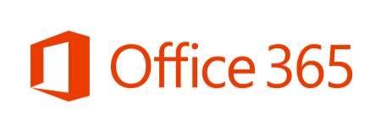
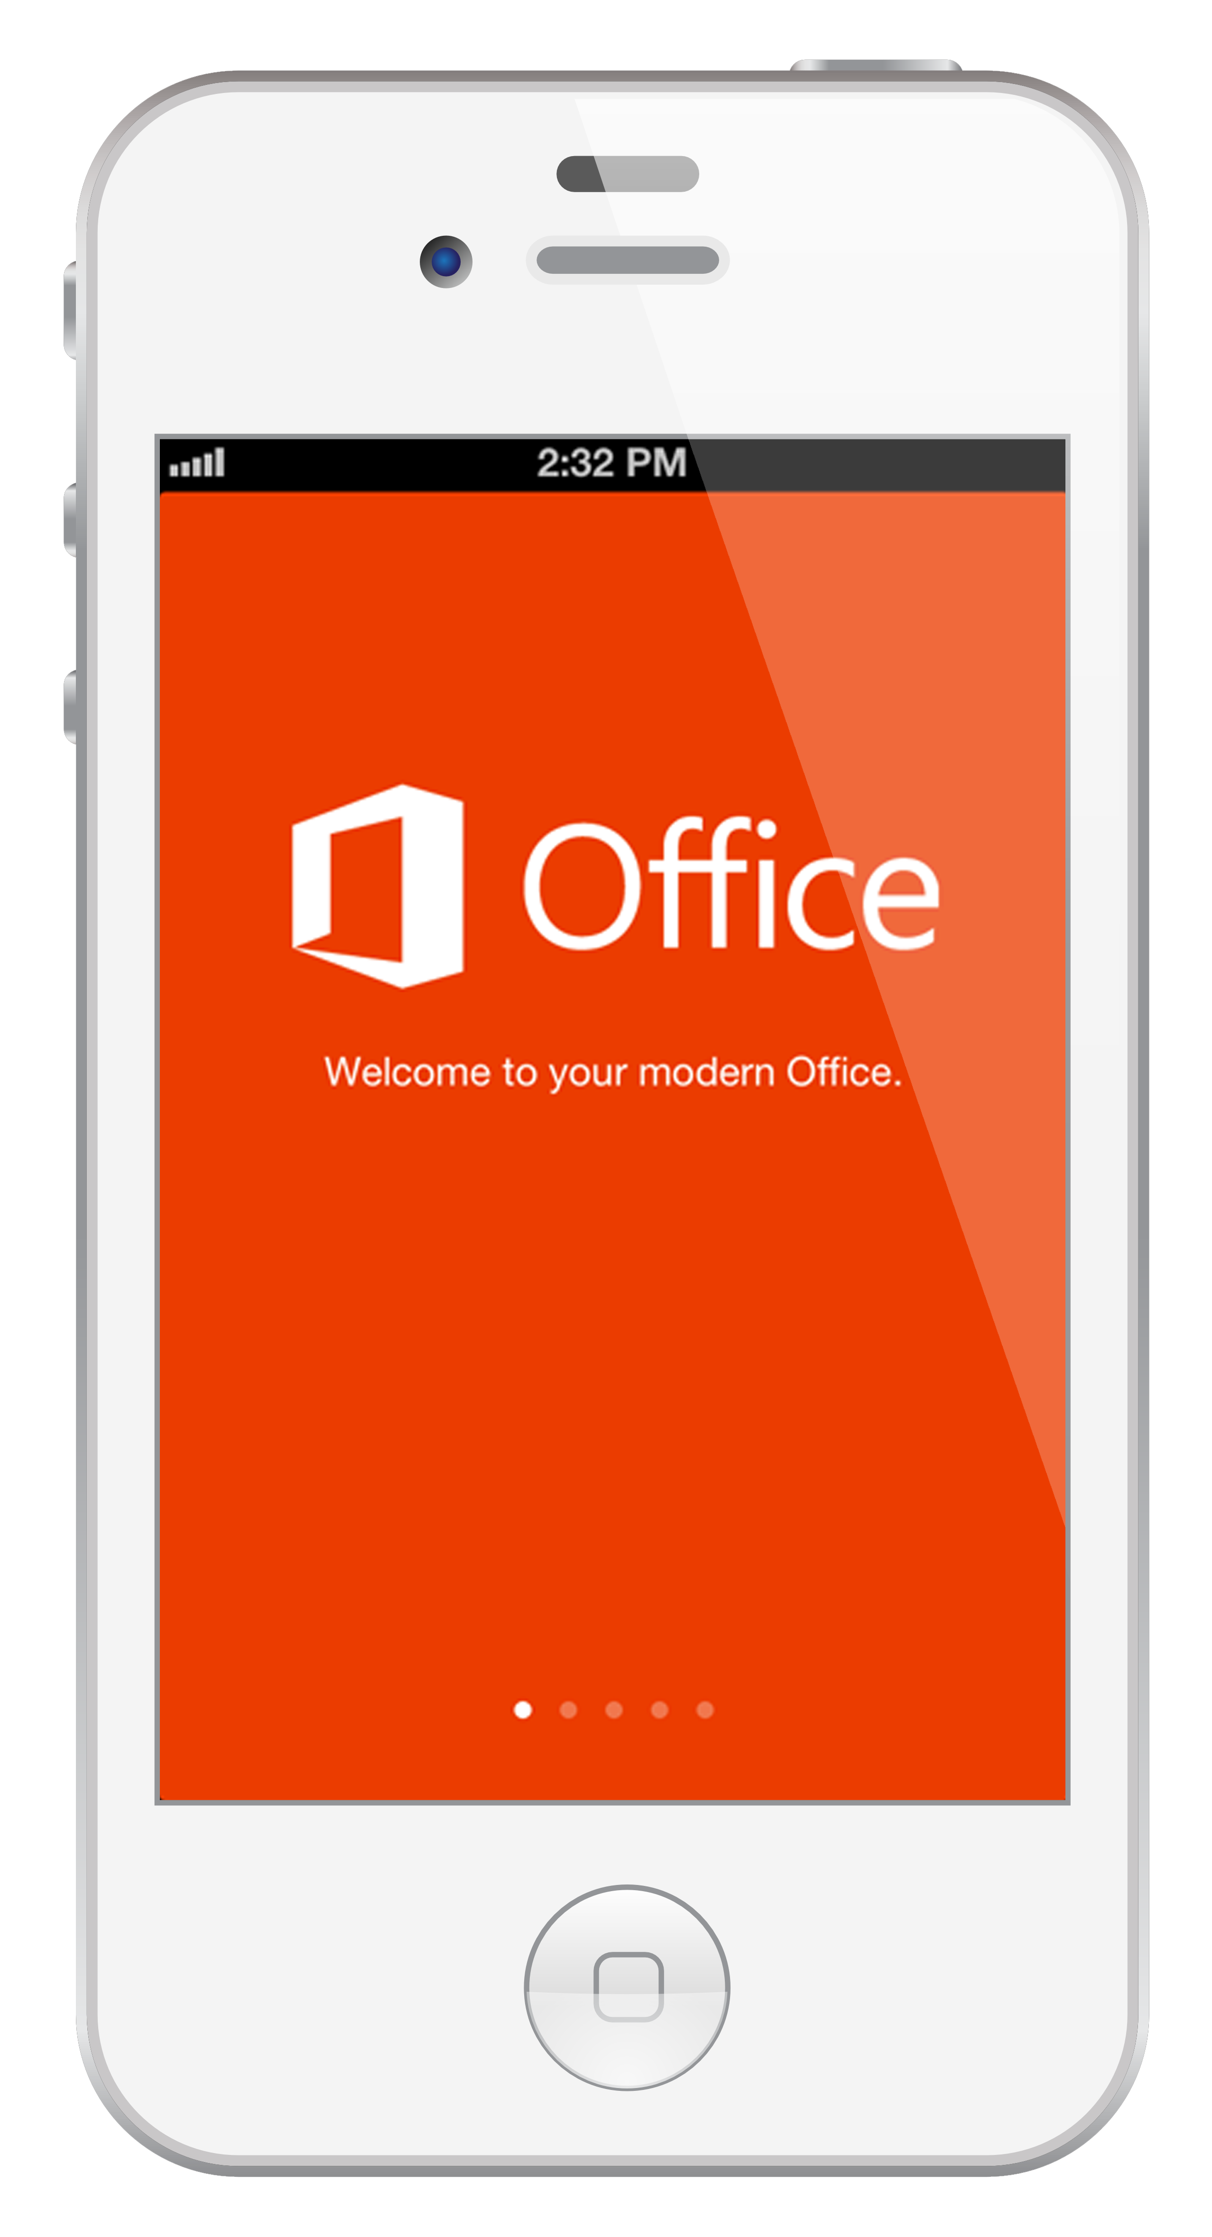
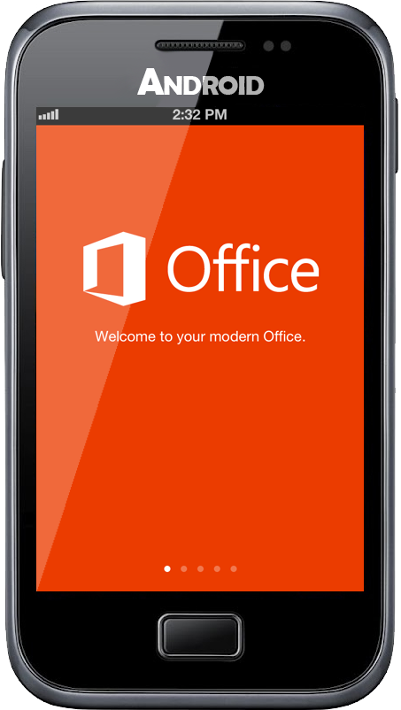
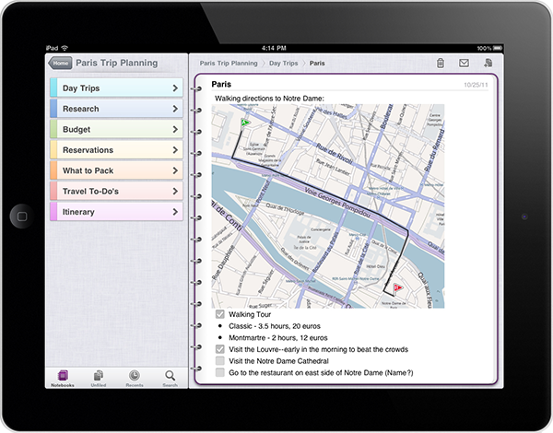
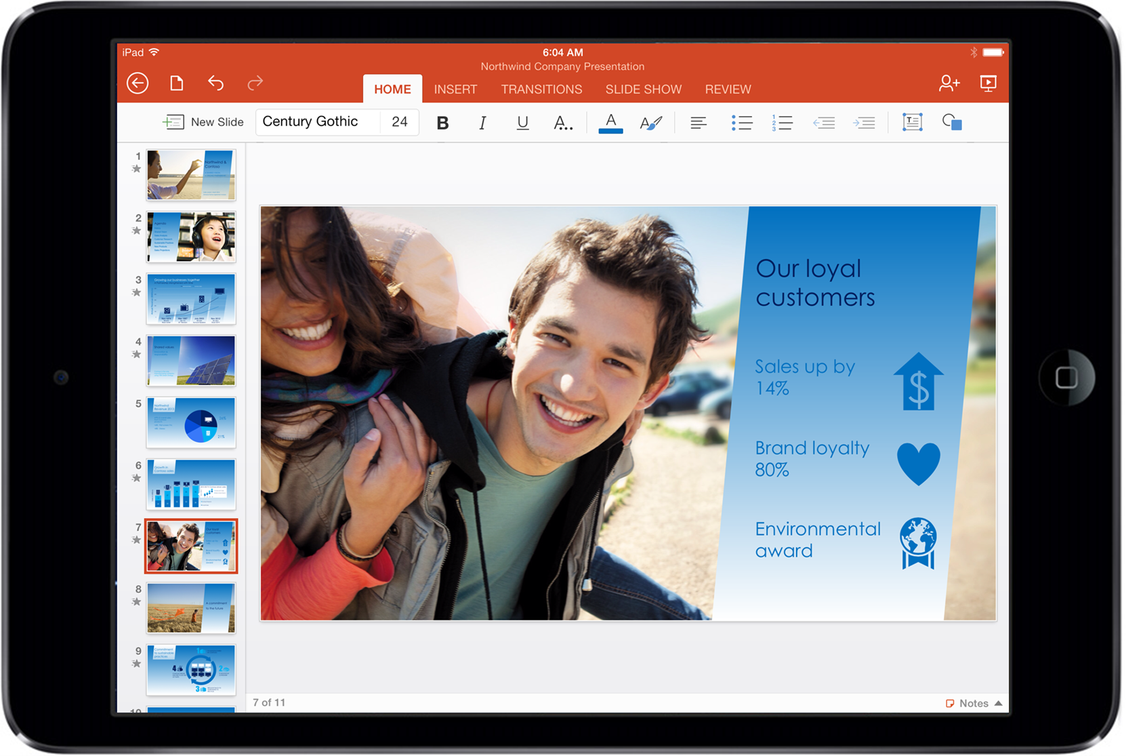
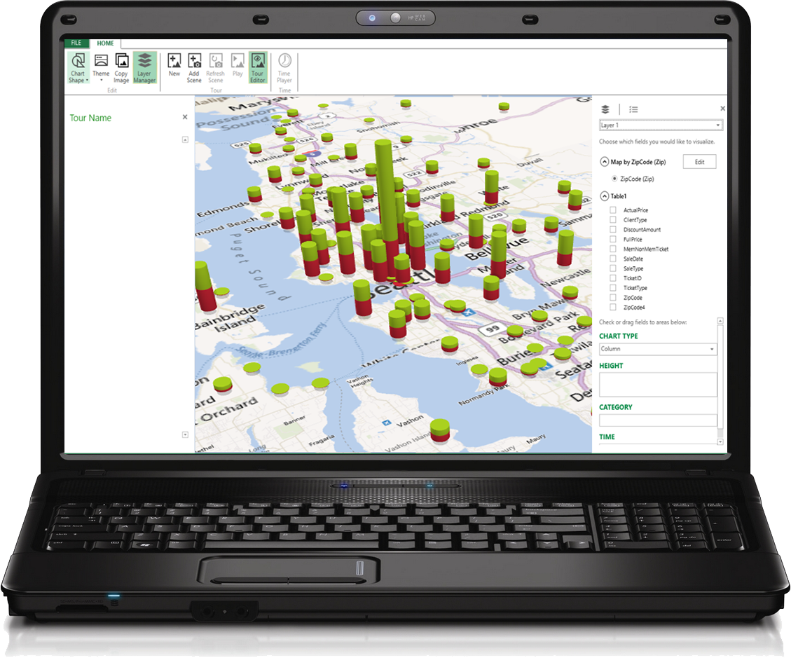
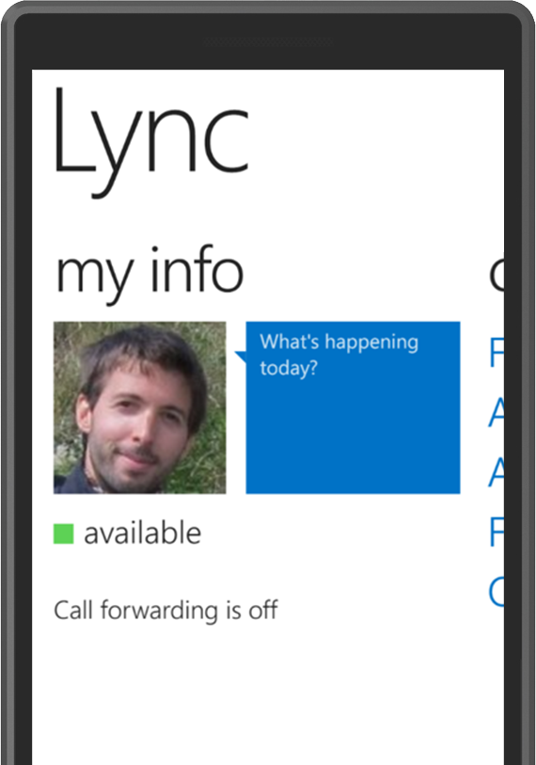

Value of Office as a Service
Microsoft is committed to keep providing additional value for Office 365 subscribers
OWA for iPad & iPhone
Lync Meeting Scheduling from OWA
Office Mobile for iPhone & Android Phones
ProPlus
PowerMap
Office for iPad
Lync Mobile Client Updates
OneNote on iPad, iPhone & Android
Lync Client Updates
Licensing & Deployment
Office Online Apps Updates
Professional Plus 2013
February 2013
Future

Slide 38
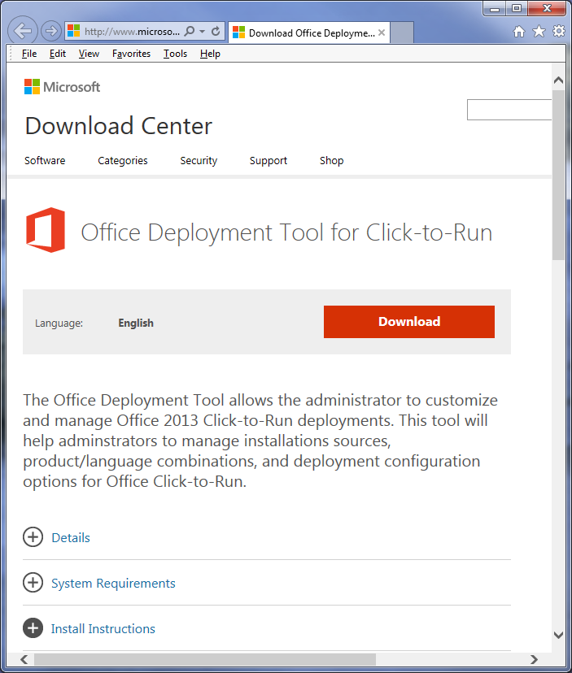

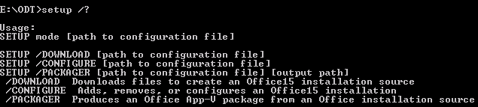
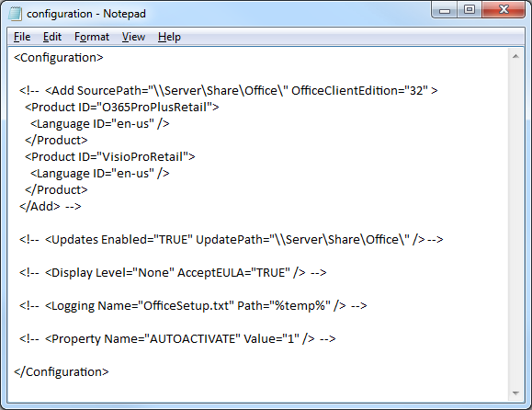
Office Deployment Tool

Slide 39
Configuration.xml example
<Configuration>
  <Add SourcePath="\\Server01\Office\" OfficeClientEdition="32">
  <Product ID="O365ProPlusRetail">
  <Language ID="en-us" />
  <ExcludeApp ID="Access" />
  <ExcludeApp ID="InfoPath"/>
  </Product>
  </Add>
  <Updates Enabled="TRUE" UpdatePath="\\Server01\Office\" />
  <Display Level="None" AcceptEULA="TRUE" />
  <Logging Name="OfficeSetup.txt" Path="%temp%" />
</Configuration>
New! (May. 2014)

Slide 40
Office 365 ProPlus Activation Activities
Initial registration/activation
Subscription status check
Product Key management
  Details:
  Frequency:
  One time, at sign-in
  Data sent:
  User ID
  Product Key
  Computer Name
  Machine ID
Details:
Frequency: Daily*
“Heartbeat” to check if subscription is active or has changed
Enabled via scheduled task
Must succeed once per 30 days
Connects to Office Licensing Service (OLS)
Data sent:
Product Key
Details:
Frequency: Once/month*
Occurs during subscription status check
Updates product key information
Extends product usage
Connects to Activation and Validation Service (AVS)
Data sent:
Product Key
TechNet: Licensing and activation data sent to Office 365 by Office 365 ProPlus
* Subject to Change

Slide 41
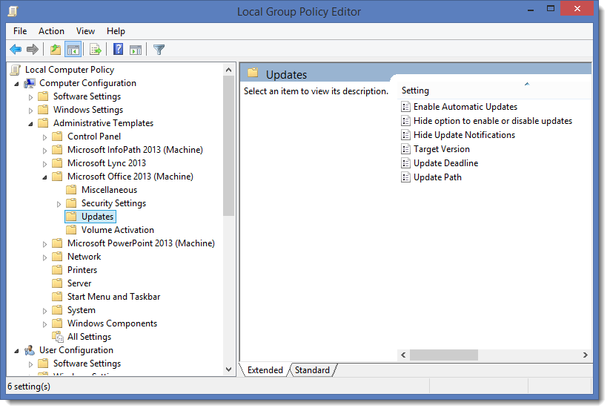
Group Policy Settings to Manage Updates
Manage Update Configuration
  Computer Configuration\
  Microsoft Office 2013\
  Updates
  Enable Automatic Updates
  Hide option to enable or disable updates
  Update Version
  Update Deadline
  Update Path
  Disable Update notifications
Office Deployment Support team blog article about update settings

Slide 42
Demonstration
Office 365 Pro Plus

Slide 43






Identity for Microsoft cloud services
Microsoft Account
Microsoft Azure Active Directory
Microsoft Account
Ex: alice@outlook.com
Organizational Account
Ex: alice@contoso.com
User
User

Slide 44

Office 365 Identity Models
Cloud identity
Synchronized identity
Federated identity
On-premises
directory
On-premises
directory
Zero on-premises
servers or no integration
Directory sync with
password sync
Federation
Directory
sync
On-premises
identity
On-premises
identity
Between zero and three additional on-premises servers depending on the number of users
Between two and eight on-premises servers
and networking configuration depending on
the sign-in availability requirements

Slide 45
DirSync requirements
64 bit Windows 2008 SP1 or higher required
  Will not install on 32 bit or client OS
A domain controller collocated install isn’t recommended
  But it is supported and you can install DirSync on the DC
One server is most common
  DirSync installs SQL Express for replication data
  You can install with dedicated SQL Server and can use HA for SQL Server
Forest Function Level
  Needs to be at 2003 minimum

Slide 46
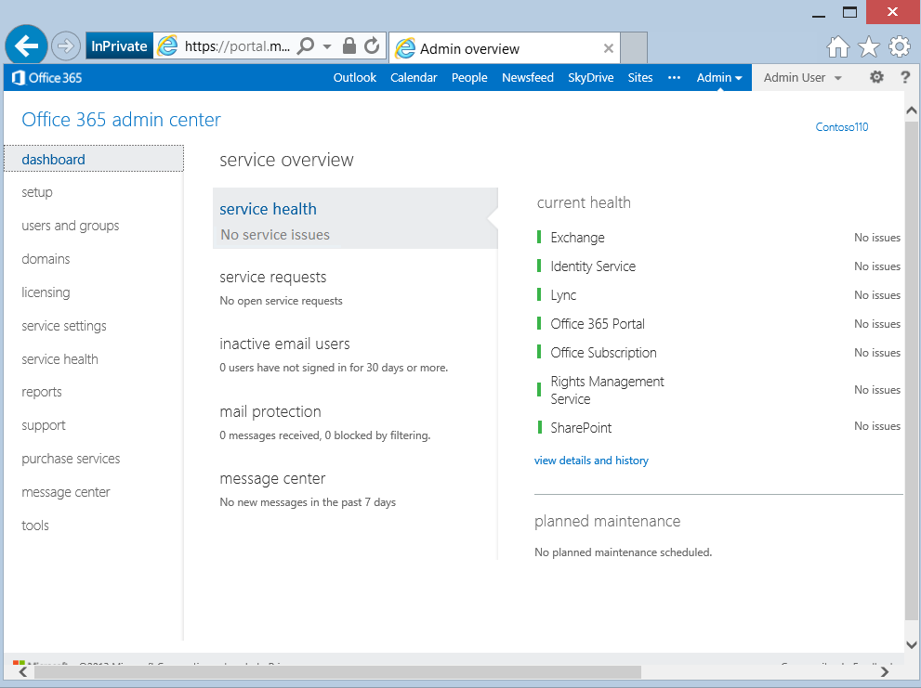
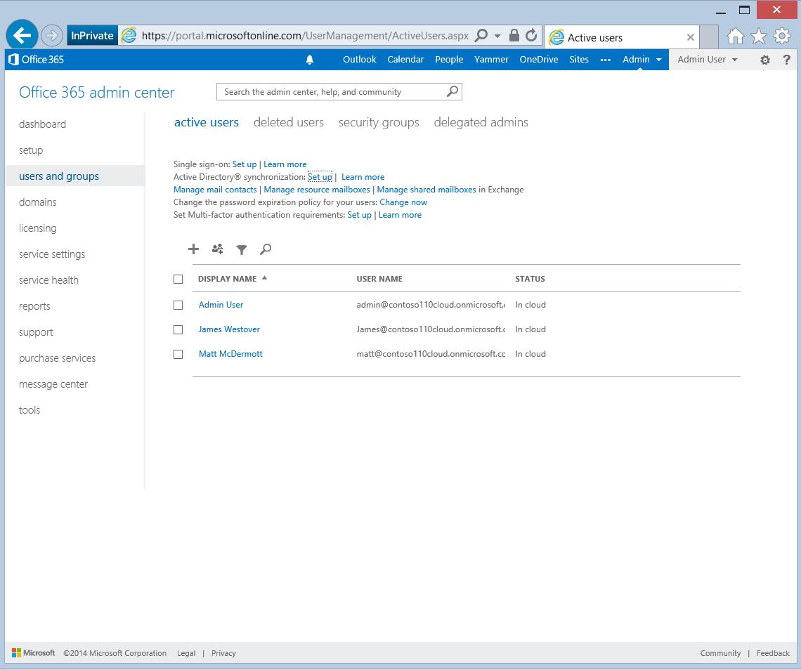
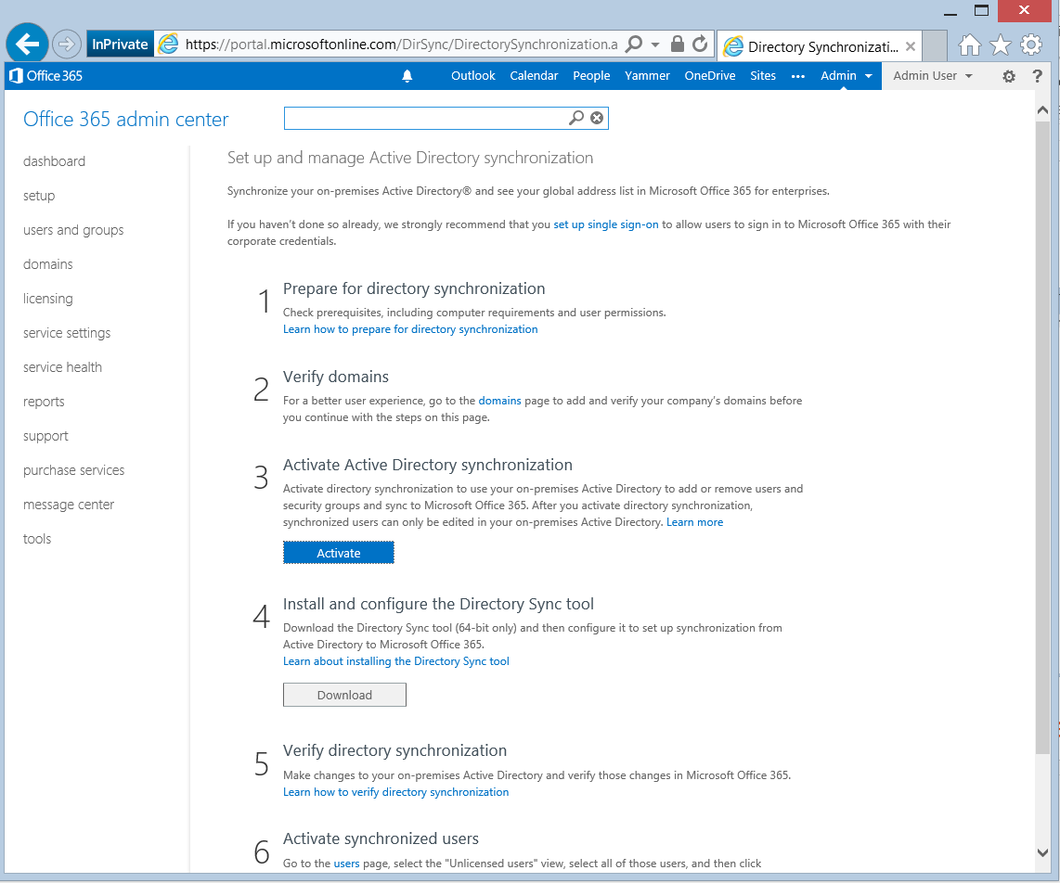
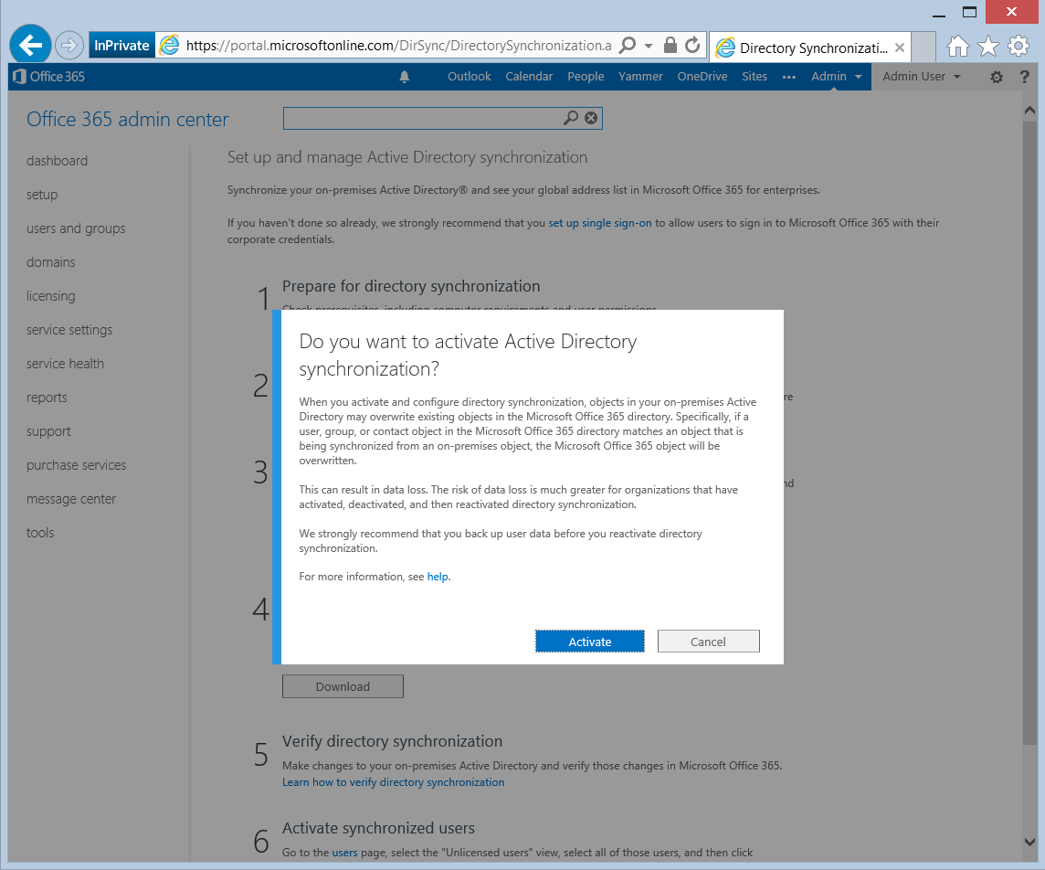
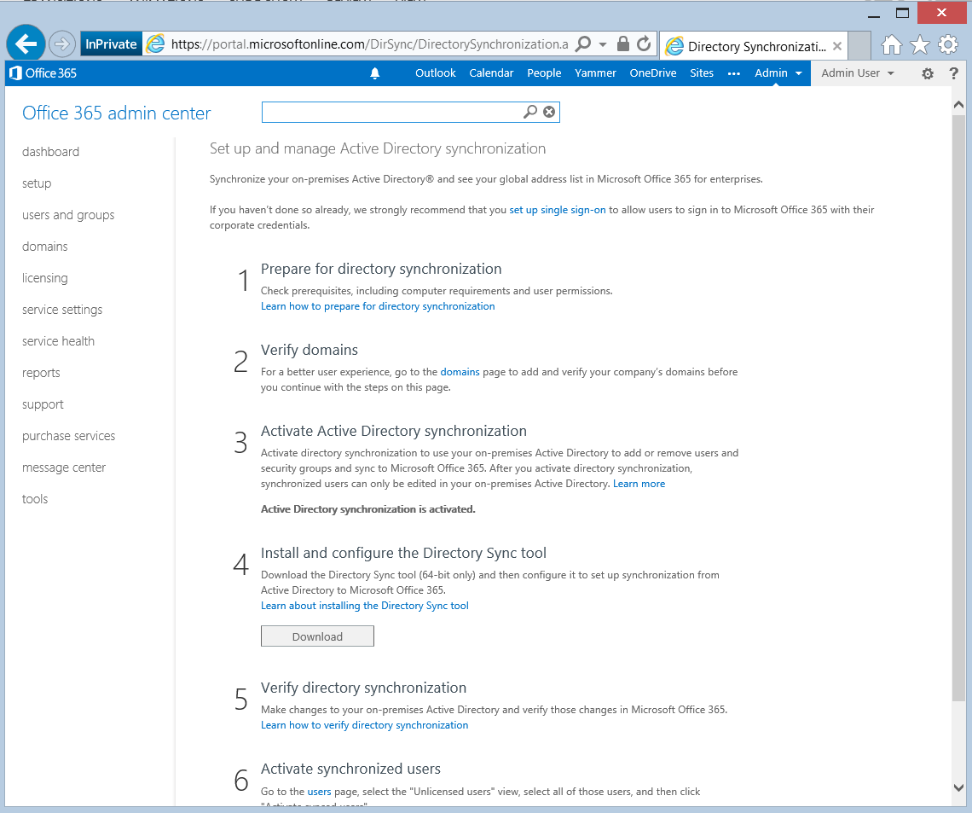
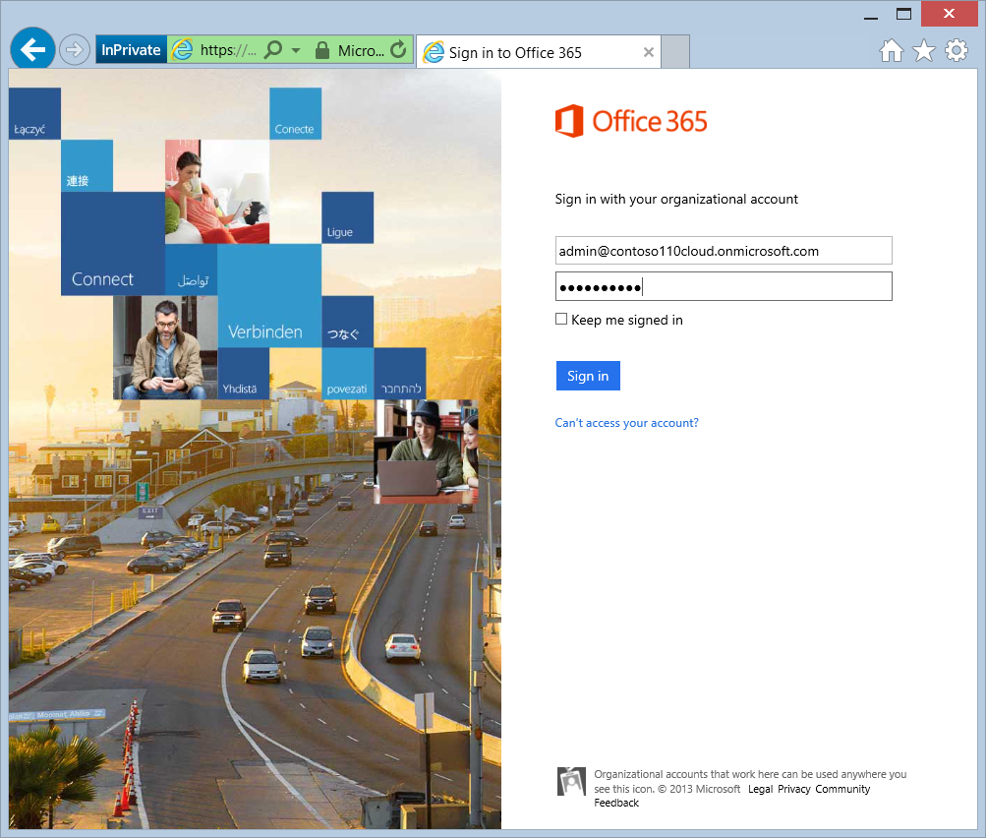
Prepare and Download DirSync
  Activate Directory Synchronization
  (can take up to 24h to propagate)
  In MOP, select
  users and groups | DirSync Set up
  Form DirSync server
  Download DirSync
Logon to the Portal
Select Users and groups and then activate DirSync
  Select Users and Groups and click Set up Active Directory synchronization
  Activate Directory Synchronization
Wait for DirSync enablement
(Use to take up to 24 hours in the past)
Review all documentation, follow the implementation steps, and download DirSync

Slide 47
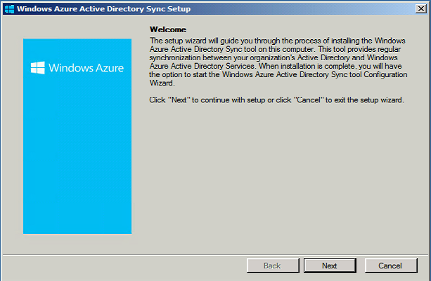
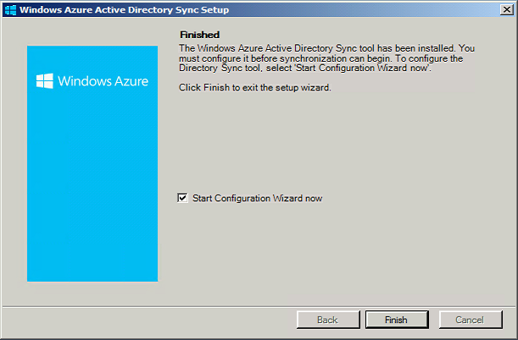
Install DirSync
Logon to DirSync server and run setup
Follow setup wizard
When finished, option to start the configuration wizard

Slide 48
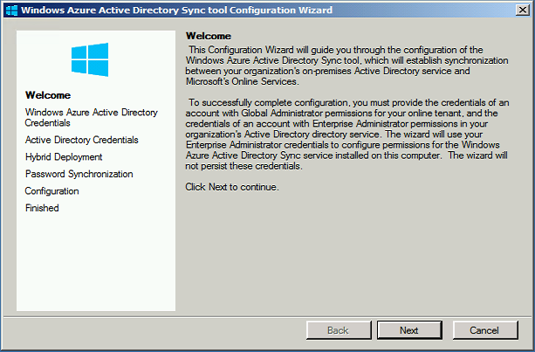
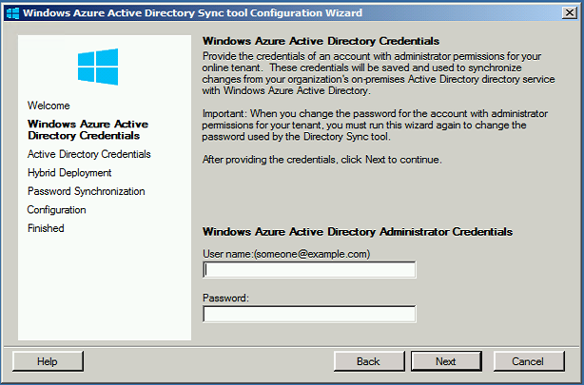
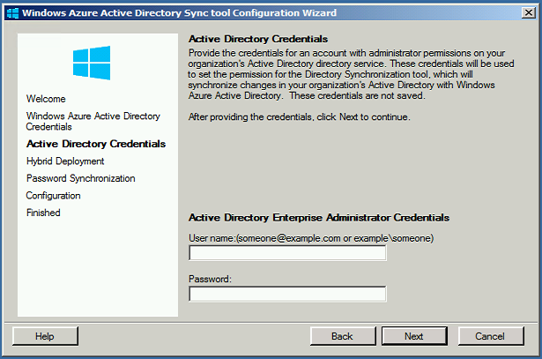
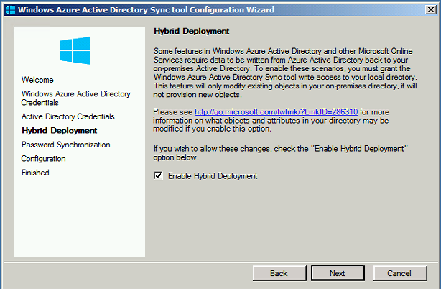
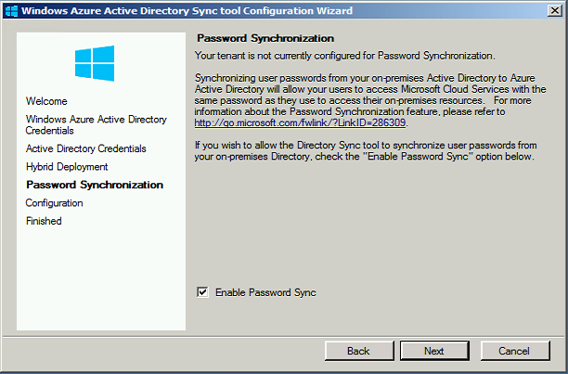
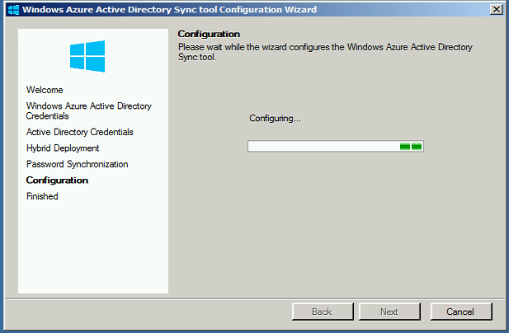
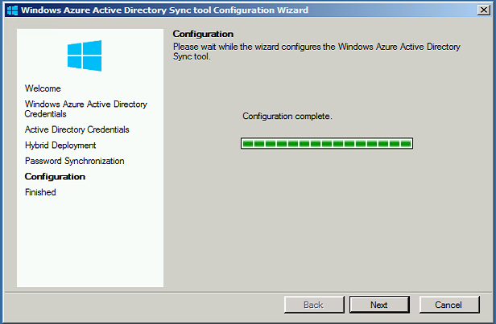
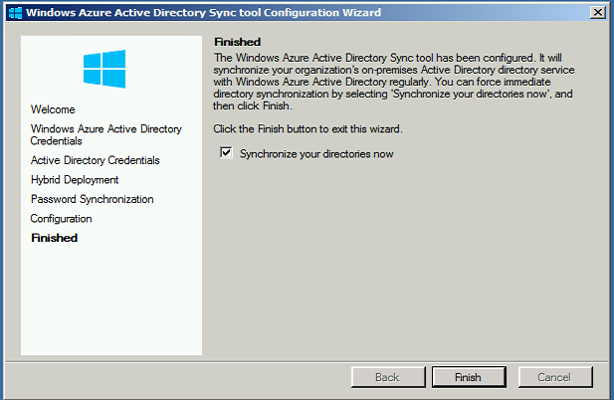
Configure DirSync
Run configuration wizard
Provide O365admin creds
Provide AD admin creds
If Exchange hybrid, configure “write-back”
Password sync option
Create configuration
When finished, option to run synchronization

Slide 49
Today’s Session
Deliver the Best of Both Worlds
Benefits extend in both directions
Windows Server 2012 R2
Leveraging the Essentials role and much more
Office 365
What is it and how is it different to previous offerings
Migration Options For Your Customers
How to get from then to now

Slide 50
Frequently raised SBS to O365 challenges
.local domains
Single server
Self signed certificates
PST Proliferation
Slow connections
Mailbox bloat
Companyweb
File shares
Scan to email
Email to print
Desktop touches
It’s different

Slide 51
Some SBS Questions To Ask
Does the customer need SBS integration with Office 365 or SBS migration to Office 365?
Should you migrate the existing AD environment or start again?
Does the customer need AD at the end of the migration?
What local services does the customer still need?
How do you set expectations for the new environment?

Slide 52
Migration guidance
TechNet migration documentation
Learn more about migrating to Windows Server 2012 R2 Essentials at
http://technet.microsoft.com/library/dn408633.aspx
Step 1: Prepare your Source Server for Windows Server 2012 R2 Essentials migration
Step 2: Install Windows Server 2012 R2 Essentials as a new replica domain controller
Step 3: Join computers to the new Windows Server 2012 R2 Essentials server
Step 4: Move settings and data to the Destination Server
Step 5: Enable folder redirection on the Destination Server
Step 6: Demote and remove the Source Server from the network
Step 7: Perform post-migration tasks for the migration.
Step 8: Run the Windows Server 2012 R2 Essentials Best Practices Analyzer.
Transition from Windows Server 2012 R2 Essentials to Windows Server 2012 R2 Standard
http://technet.microsoft.com/en-us/library/jj247582.aspx

Slide 53
Exchange Online Migration Options
PST Migration
  New service mailbox
  User or IT PST migration options
 | PST | IMAP | Cutover | Staged | 2010 Hybrid | 2013 Hybrid
Exchange 5.5 | ■ | ■
Exchange 2000 | ■ | ■
Exchange 2003 | ■ | ■ | ■ | ■ | *
Exchange 2007 | ■ | ■ | ■ | ■ | * | *
Exchange 2010 | ■ | ■ | ■ |  | ■ | *
Exchange 2013 | ■ | ■ | ■ |  |  | ■
Notes/Domino |  | ■
GroupWise |  | ■
Other | ■ | ■
IMAP Migration
  Supports wide range of email platforms
  Email only (no calendar, contacts, or tasks)
Service Migrations
Cutover Exchange Migration (CEM)
  Good for fast cutover migrations
  No migration tool or computer required on-premises
Staged Exchange Migration (SEM)
  No migration tool or computer required on-premises
  Requires Directory Synchronization with on-premises AD
Hybrid Deployment
  Manage users on-premises and online
  Enables cross-premises calendaring, smooth migration, and easy off-boarding
Hybrid

Slide 54
Third Party Migration Tools
Always use them with SBS 2003 migrations
Strongly recommend them during SBS 2008 and SBS 2010 migrations to simplify the process
Choose the tool based on what you need assistance with

Slide 55

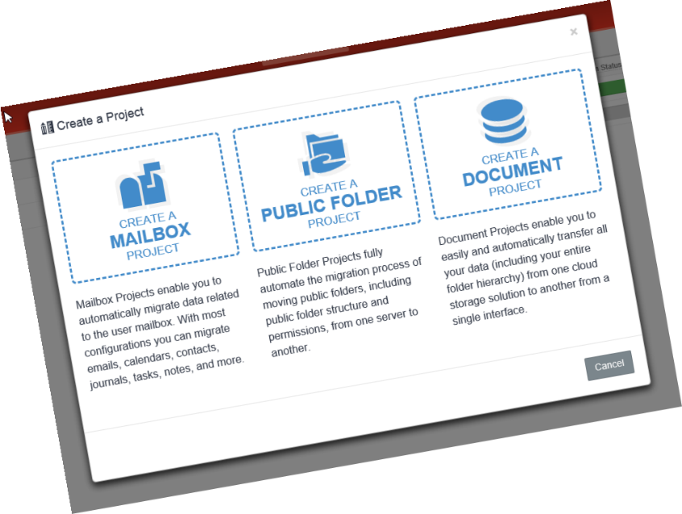
Data migration solution
Mailbox, Public Folders, Documents, Archives etc
The worlds only enterprise cloud-based migration service
No hardware or software to install
Access using web browser and internet
Sign-up, configure, purchase and submit migrations online using web browser in minutes with no prior experience

Slide 56

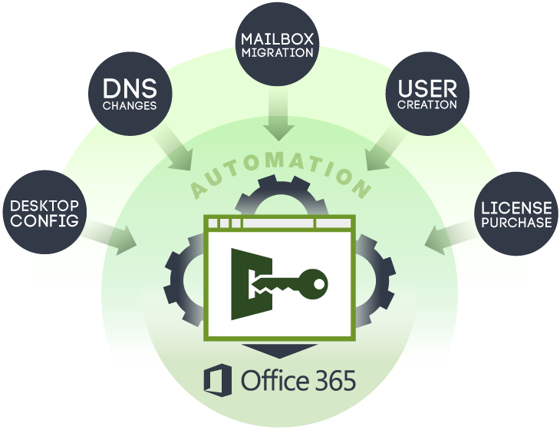
Automated End-to-end Onboarding to Office 365
SaaS platform that automates the entire onboarding process for new customers to Office 365
Office 365 Tenant – Create New or Use Existing Tenant Account
User Discovery and Provisioning
  Users, distribution groups, shared mailboxes, resources
Mailbox Migration
  Emails, calendars, contacts, journal, notes and tasks
  Outlook rules
  Folder permissions
Desktop Deployment - Outlook Configuration
  Create a new Profile
  Migrate Settings – Signatures
    Autocomplete (Nk2 file)- coming soon
    Color categories – coming soon
  PST Reattachment
  Bypass on premise autodiscover
Schedule and Automate DNS changes

Slide 57

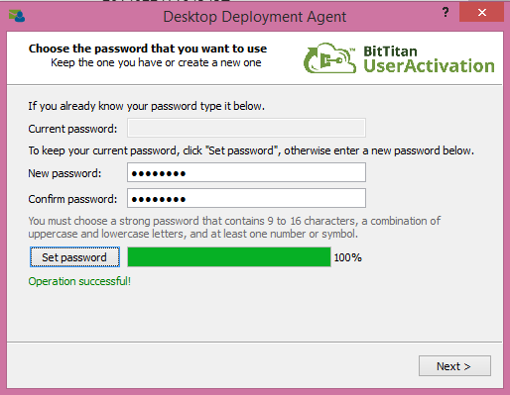
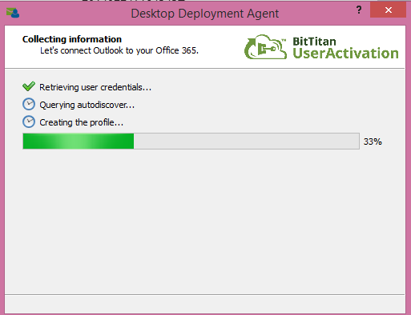
Automatically configure Outlook 2007+ to connect to Office 365
  Securely create a new profile
  Allows users to set their own password
  Attach existing .psts
  Migrate signature
  Auto complete coming soon!
Deploy to any size organization
  Individual install through unique end user emails
  Shared folder install
  Silent Install via Group Policy deployment
Deploy users in any migration scenario
  Cutover or Staged / Hybrid
No Admin Credentials Needed!
Direct Integration with MigrationWiz / UserActivation
Fully Customizable

Slide 58
Demonstration
BitTitan Migration Tools

Slide 59
PST Capture Tool
Stand alone tool to capture and migrate PST data
Option to import to mailbox or archive
Requires central PST capture console installation
Agent required on client computers for capture and migration

Slide 60
Demonstration
PST Migration Tool

Slide 61








Cutover Migration Flow
Configure Outlook Anywhere
Test using ExRCA
Assign migration
perms
Wizard:
Enter server settings and admin
creds
Migration
tool
provisions
users mailboxes
DLs
contacts
in O365
Initial
sync
Change MX
record
Mark migration as complete
Final
sync and cleanup
License users
Delta
sync
every 24 hours

Slide 62
Staged Migration Flow
Configure Outlook Anywhere
Test using ExRCA
Assign migration
perms
Configure Directory
Sync
Wizard:
Enter server settings and admin
creds
Initial
sync
Change MX
record
Mark migration as complete
Final
sync and cleanup
License users
Delta
sync
every 24 hours

Slide 63



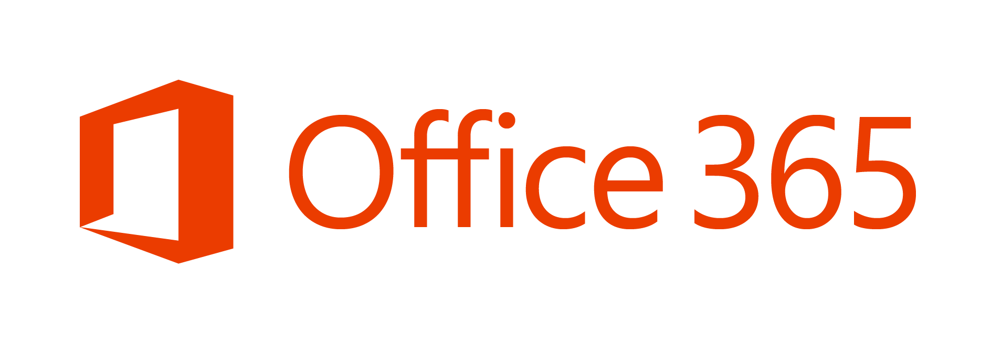
Hybrid
Deployments

Slide 64
Hybrid Coexistence Feature Comparison
Feature | Simple | Hybrid
Mail routing between on-premises and cloud (recipients on either side) | ■ | ■
Mail routing with shared namespace (if desired) on both sides | ■ | ■
Unified GAL | ■ | ■
Free/Busy and calendar sharing cross-premises |  | ■
Out of Office understands that cross-premises is “internal” to the organization |  | ■
Mailtips, messaging tracking, and mailbox search work cross-premises |  | ■
OWA redirection cross-premise (single OWA URL for both on-premises and cloud) |  | ■
Single tool to manage cross-premises Exchange functions (including migrations) |  | ■
Mailbox moves support both onboarding and offboarding |  | ■
No outlook reconfiguration or OST resync required after mailbox migration |  | ■
Preserve auth header (ensure internal email is not spam, resolve against GAL, etc.) |  | ■
Centralized mail flow , ensures that all email routes inbound/outbound via on-prem |  | ■

Slide 65
Demonstration
Exchange Hybrid

Slide 66
Summary
Deliver the Best of Both Worlds
Benefits extend in both directions
Windows Server 2012 R2
Leveraging the Essentials role and much more
Office 365
What is it and how is it different to previous offerings
Migration Options For Your Customers
How to get from then to now

Slide 67
Next Steps
Get and stay Ahead of the Game
http://aka.ms/AheadoftheGame
Drive Office 365 demand with BEST
http://aka.ms/BEST
Leverage the Best of Both Worlds campaign
Contact your PAM to learn more about programs and offers available

Slide 68
Resources
Windows Server Essentials Tech Center
http://technet.microsoft.com/en-US/sbs/jj159331
Windows Server Essentials and Small Business Server blog
http://blogs.technet.com/b/sbs/
Windows Server Essentials support forum
http://social.technet.microsoft.com/forums/en-us/
winserveressentials/threads
Windows Server 2012 R2 product page
http://www.microsoft.com/en-us/server-cloud/products/
windows-server-2012-r2/default.aspx
Windows Server 2012 R2 Essentials product page
http://www.microsoft.com/en-us/server-cloud/products/
windows-server-2012-r2-essentials/default.aspx

Slide 69

Additional Partner Resources
Ahead of the Game Marketing Content
http://aka.ms/AheadoftheGame
SMB and Midmarket Competencies
  http://partner.Microsoft.com
Partner Learning Center:
  https://mspartner.microsoft.com/en/us/Pages/Training/partner-learning-center.aspx
Microsoft Virtual Academy
http://www.microsoftvirtualacademy.com/
ISV Upgrade Support
Email isvupgrade@microsoft.com with app name and name of ISV

Slide 70
Product & Licensing Resources
Windows
Server
2012 R2
  Windows Server Partner Resources:
  https://mspartner.microsoft.com/en/us/Pages/Solutions/microsoft-windows-server.aspx
  Windows Server Technical Resources:
  http://technet.microsoft.com/en-us/windowsserver
Windows
Azure
Windows Azure Partner Resources:
https://mspartner.microsoft.com/en/us/pages/solutions/windows-azure-platform.aspx
Windows Azure Technical Resources:
http://msdn.microsoft.com/en-us/library/windowsazure/
Microsoft
Volume
Licensing
Microsoft Volume Licensing Resources:
http://www.microsoft.com/licensing/
Microsoft Licensing Advisor:
http://mla.microsoft.com/

