Slide 1

Introducing The Windows 8.1 Update
Mark O’Shea | Microsoft MVP Windows Expert – IT Pro

Slide 2
Agenda
What was new in the Windows 8.1 user experience?
What is new in the Windows 8.1 Update user experience?
Next steps…

Slide 3
What was new in the Windows 8.1 User Experience?

Slide 4



What Windows 7 elements are in Windows 8.1?
Desktop experience
  Start
  Snapping
  Taskbar
  Jump Lists
  Pinning
  Thumbnails

Slide 5
User Experience
Boot to Desktop
    Boot directly to desktop
    Only leave the desktop when you want
Multi monitor
    Scaling for each display
    Control of Start Screen location

Slide 6
User Experience
Start Screen Improvements
    More options for Start screen organization
    More tile sizes available
    IT can control layout and settings via policy
    Consistent background between desktop and Start screen
    Apps are not added to the Start screen by default
New Search Experience
Snapping Apps

Slide 7
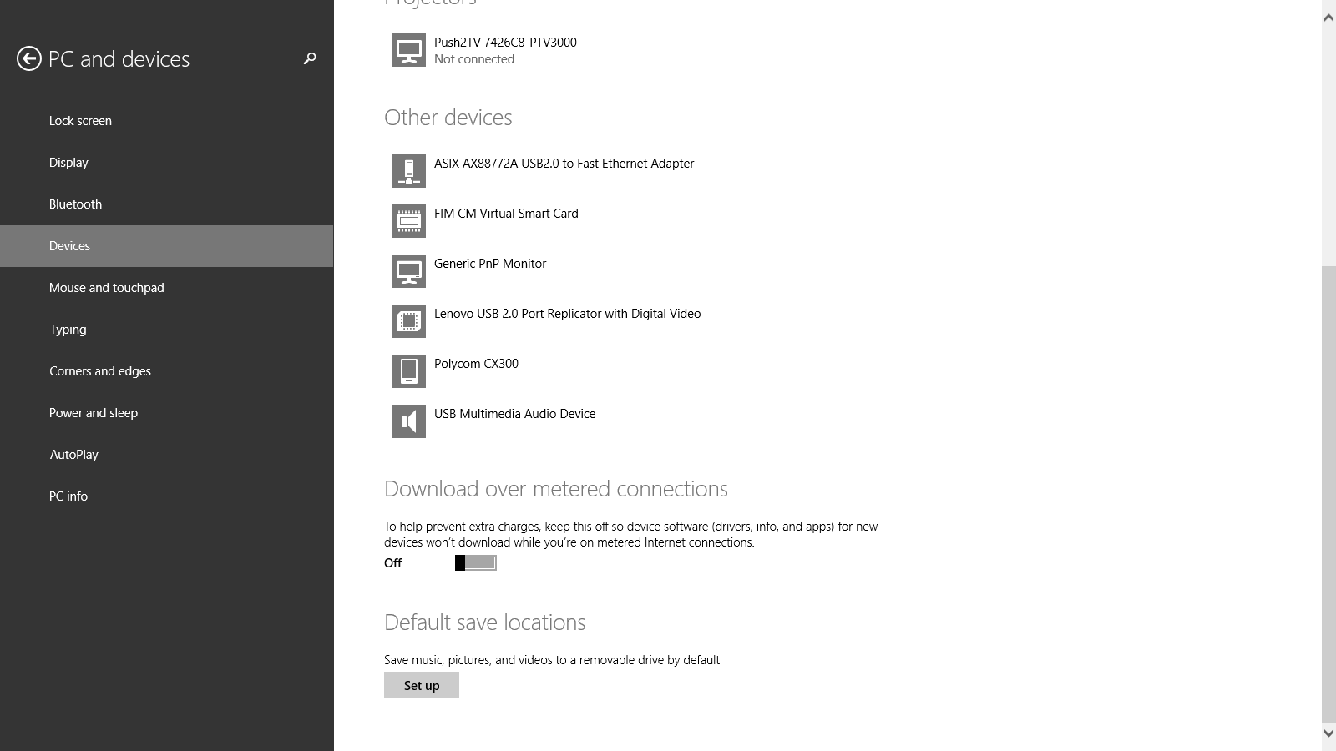
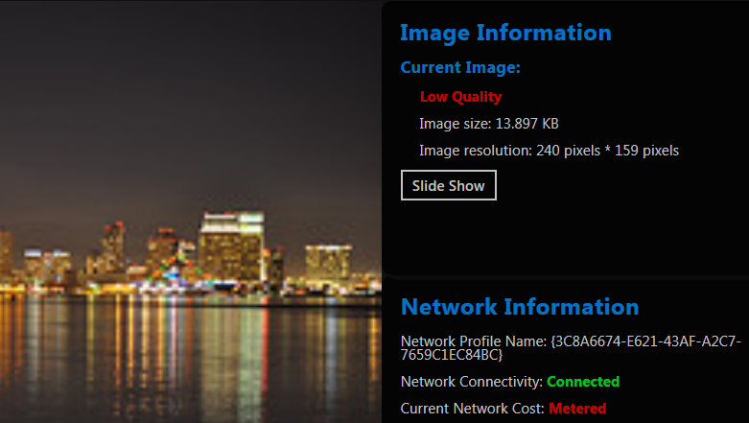
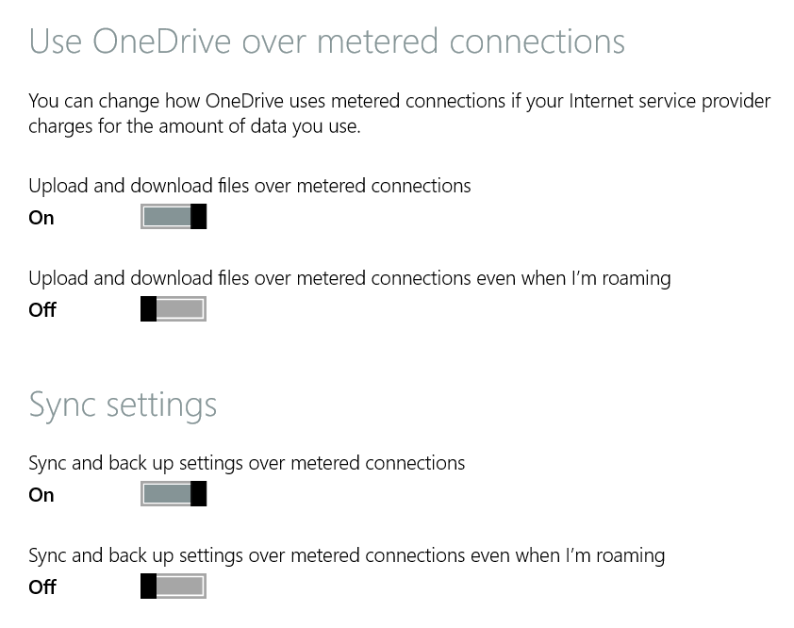
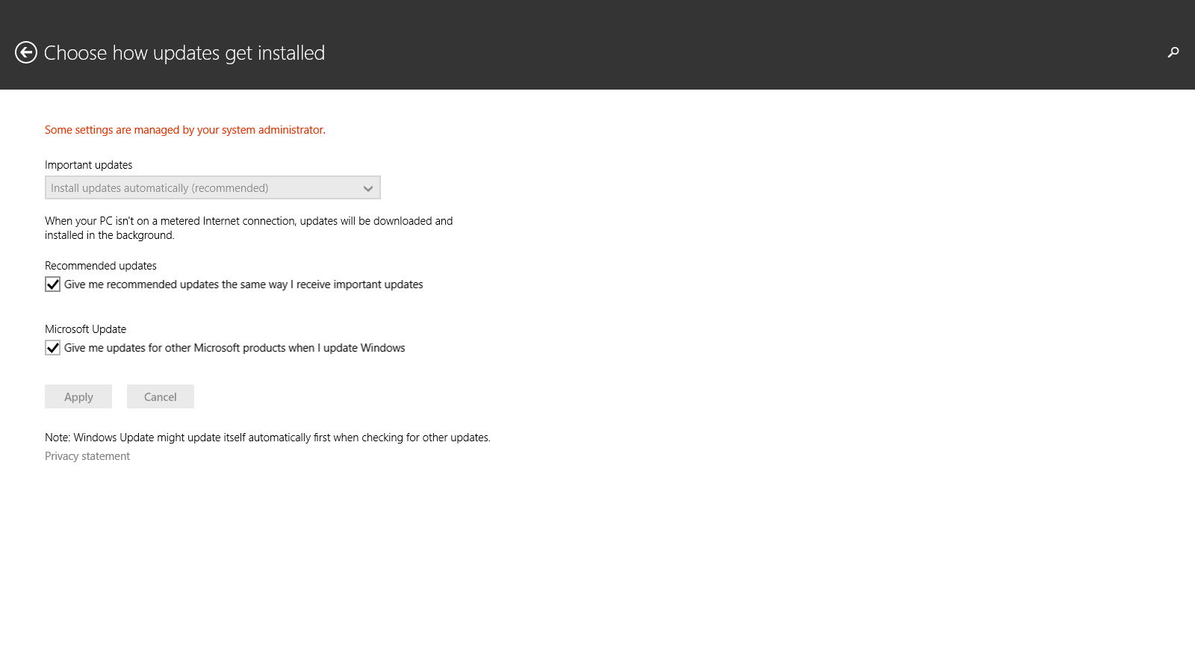
Windows 8.1:
Mobile broadband
Optimising end-user experiences
Metered connection aware
applications
Efficient data usage with mobile broadband
Track usage on wireless connections

Slide 8
Application
updates
Automatic installation
Group policy can disable auto install, but enabled by default
Updates can still install without a Microsoft account
Installation when the Windows Store is disabled
Group policy can disable the Windows Store for the user, but still allow updates to install
Disabling the Windows Store for the computer prevents update installation
Works behind proxy servers
Addresses common issue in Windows 8

Slide 9
Windows 8.1 Interface Enhancements

Slide 10
What is new in the Windows 8.1 Update user experience?

Slide 11
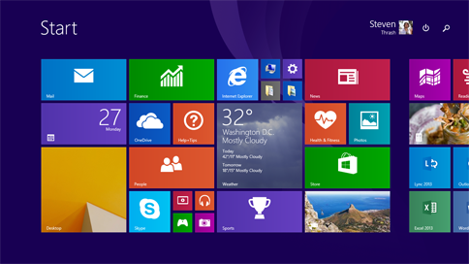
Start Screen
    Enhanced for mouse and touch
    Right click on app tiles to see more options
    Recently installed apps
    Power and search buttons
    Taskbar available

Slide 12
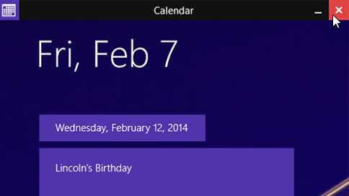
Modern Apps
Enhanced for mouse and touch
    Minimise and close buttons
    Taskbar available
    Minimise and close to desktop

Slide 13
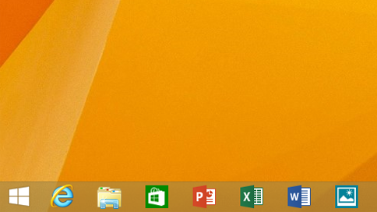
Desktop
Ongoing integration with Modern Apps
Modern apps are first class citizens on the taskbar
Open and pinned apps appear in taskbar including live previews

Slide 14
Windows 8.1 Update Interface Enhancements

Slide 15
Next Steps
Visit www.intunedin.net to…
Register for the next two webinars in this series
For links to further resources
To download today’s presentation

